Slide 1

ChatGPT and Search
Ferosh Jacob

Slide 2


Turing Test
Can machines THINK? (1950)

Slide 3
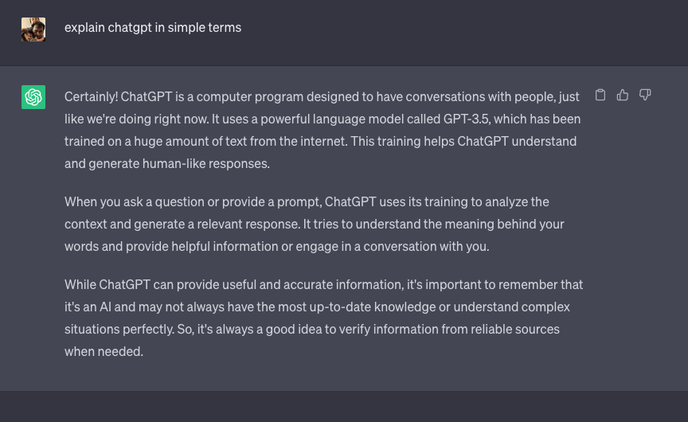
What is ChatGPT?

Slide 4
ChatGPT demo?

Slide 5
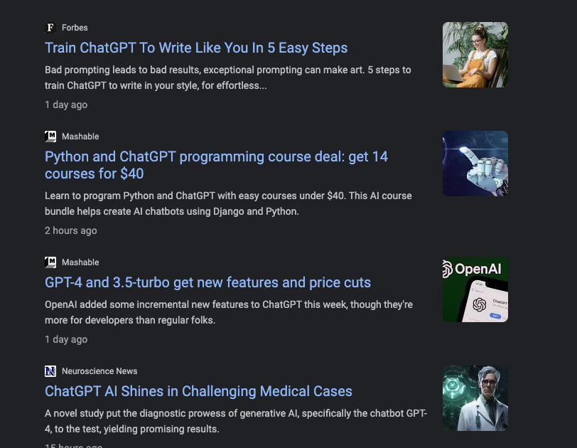
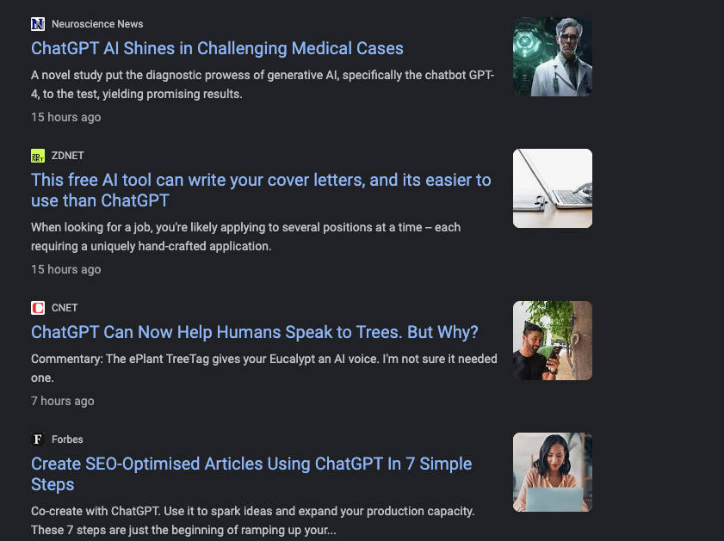
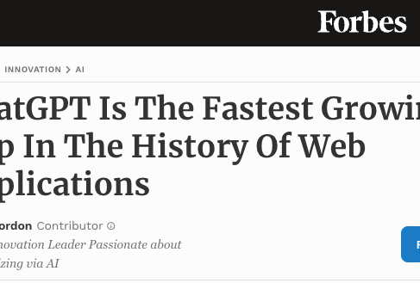
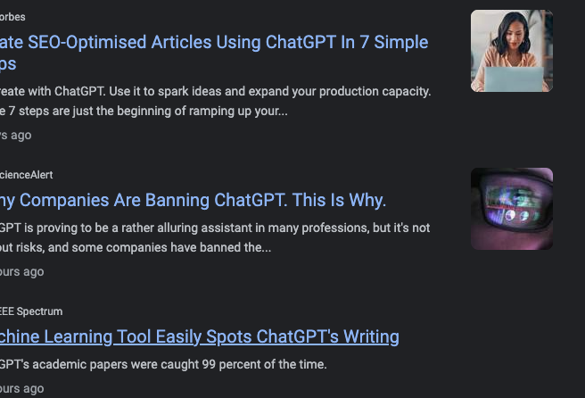
ChatGPT in news

Slide 6
Who was the president of us when queen elizabeth became queen?
Do you know the answer?
Let’s analyze this question
Can you think of any approach to answer this question?

Slide 7
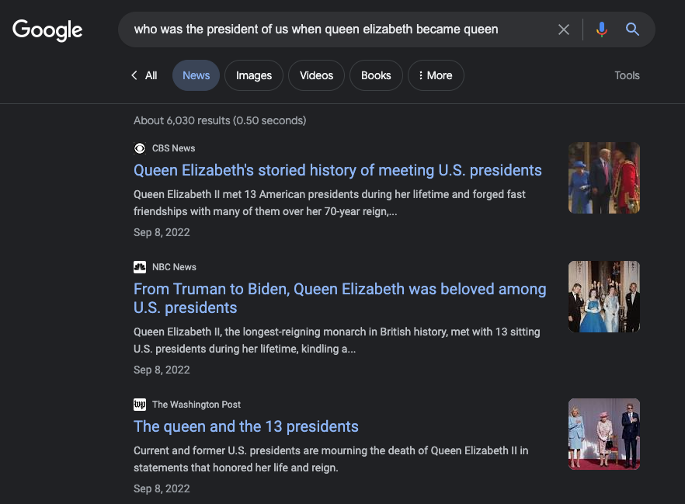
If you didn’t know, you are not alone

Slide 8
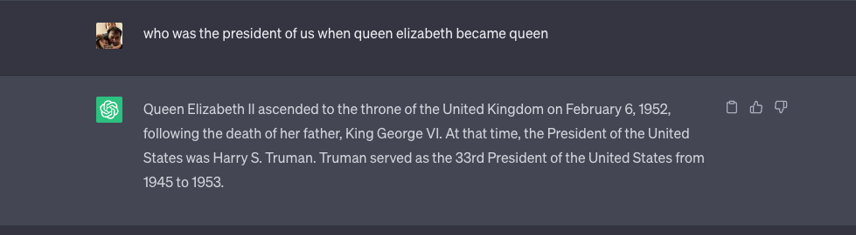
What about ChatGPT?

Slide 9
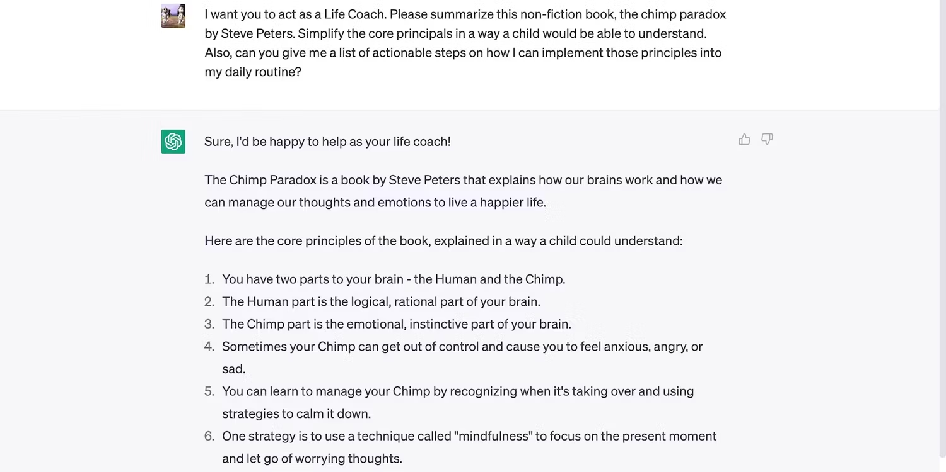
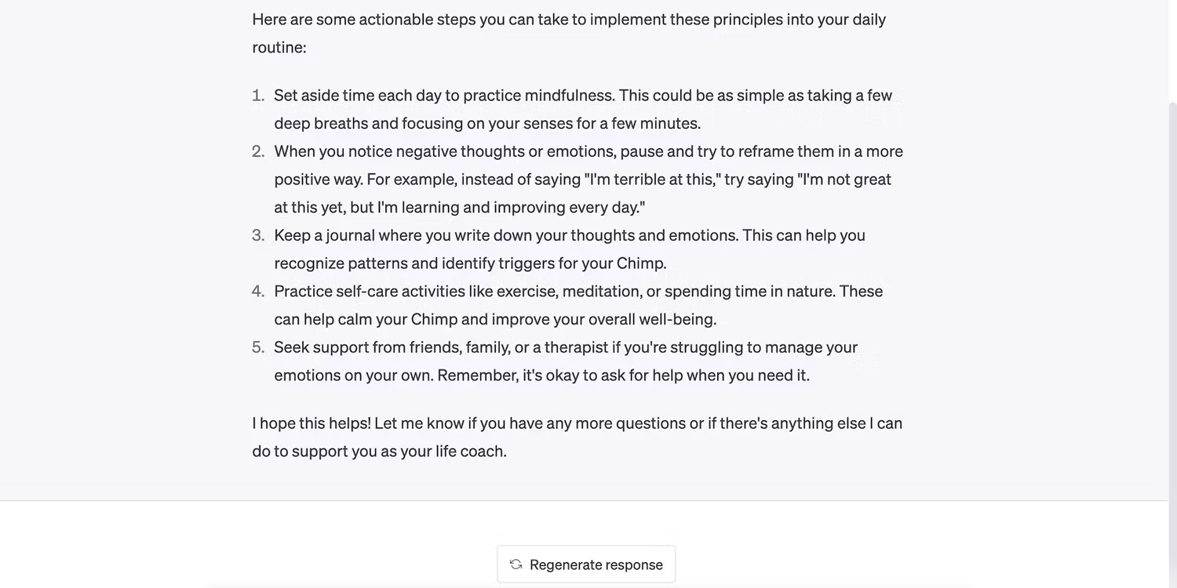
Why do I need search if I have ChatGPT?

Slide 10
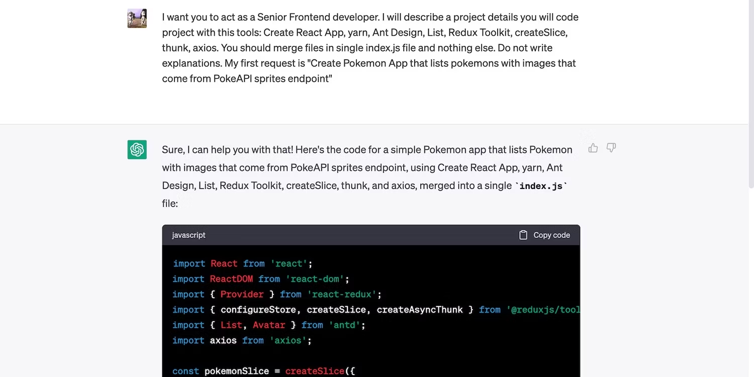
Why do I need search if I have ChatGPT?

Slide 11
Interesting, Tell me the bad things now
In the last example, How will you validate the answer whether Truman was really the president when Queen Elizabeth was throned, every one keep on saying ChatGPT can make up stuff
I used Google ☺
Training is rigorous and the data is not up to date

Slide 12
AI Powered search was always a dream
Let’s quickly understand search or IR system before trying to answer whether ChatGPT can take over search engines

Slide 13
IR System
Document
corpus
IR
System
Query String
1. Doc1
2. Doc2
3. Doc3
.
.
Ranked
Documents

Slide 14
Web Search System
Web
Spider
Document
corpus
IR
System
Query String
1. Page1
2. Page2
3. Page3
.
.
Ranked
Documents

Slide 15
Relevance
Relevance is a subjective judgment and may include:
Being on the proper subject.
Being timely (recent information).
Being authoritative (from a trusted source).
Satisfying the goals of the user and his/her intended use of the information (information need).

Slide 16
Keyword Search
Simplest notion of relevance is that the query string appears verbatim in the document.
Slightly less strict notion is that the words in the query appear frequently in the document, in any order (bag of words).

Slide 17
Problems with Keywords
May not retrieve relevant documents that include synonymous terms.
“restaurant” vs. “café”
“PRC” vs. “China”
May retrieve irrelevant documents that include ambiguous terms.
“bat” (baseball vs. mammal)
“Apple” (company vs. fruit)
“bit” (unit of data vs. act of eating)

Slide 18
Intelligent IR
Taking into account the meaning of the words used.
Taking into account the order of words in the query.
Adapting to the user based on direct or indirect feedback.
Taking into account the authority of the source.

Slide 19
History of IR
1960-70’s:
Initial exploration of text retrieval systems for “small” corpora of scientific abstracts, and law and business documents.
Development of the basic Boolean and vector-space models of retrieval.
Prof. Salton and his students at Cornell University are the leading researchers in the area.

Slide 20
IR History Continued
1980’s:
Large document database systems, many run by companies:
Lexis-Nexis
Dialog
MEDLINE

Slide 21
IR History Continued
1990’s:
Searching FTPable documents on the Internet
Archie
WAIS
Searching the World Wide Web
Lycos
Yahoo
Altavista

Slide 22
IR History Continued
1990’s continued:
Organized Competitions
NIST TREC
Recommender Systems
Ringo
Amazon
NetPerceptions
Automated Text Categorization & Clustering

Slide 23
IR History Continued
2000’s
Link analysis for Web Search
Google
Automated Information Extraction
Parallel Processing
Map/Reduce
Question Answering
TREC Q/A track

Slide 24
IR History Continued
2000’s continued:
Multimedia IR
Image
Video
Audio and music
Cross-Language IR
DARPA Tides
Document Summarization
Learning to Rank

Slide 25
Recent IR History
2010’s
Intelligent Personal Assistants
Siri
Cortana
Google Now
Alexa
Complex Question Answering
IBM Watson
Distributional Semantics
Deep Learning
ChatGPT ☺

Slide 26
Clearly ChatGPT can chat !
In IR, there are follow up questions and that is a use case not well supported now
In IR, there are
ORA (One Right Answer) – ChatGPT is better?
NORA (No One Right Answer)
You like someone summarize it for you
You like to see as it is

Slide 27
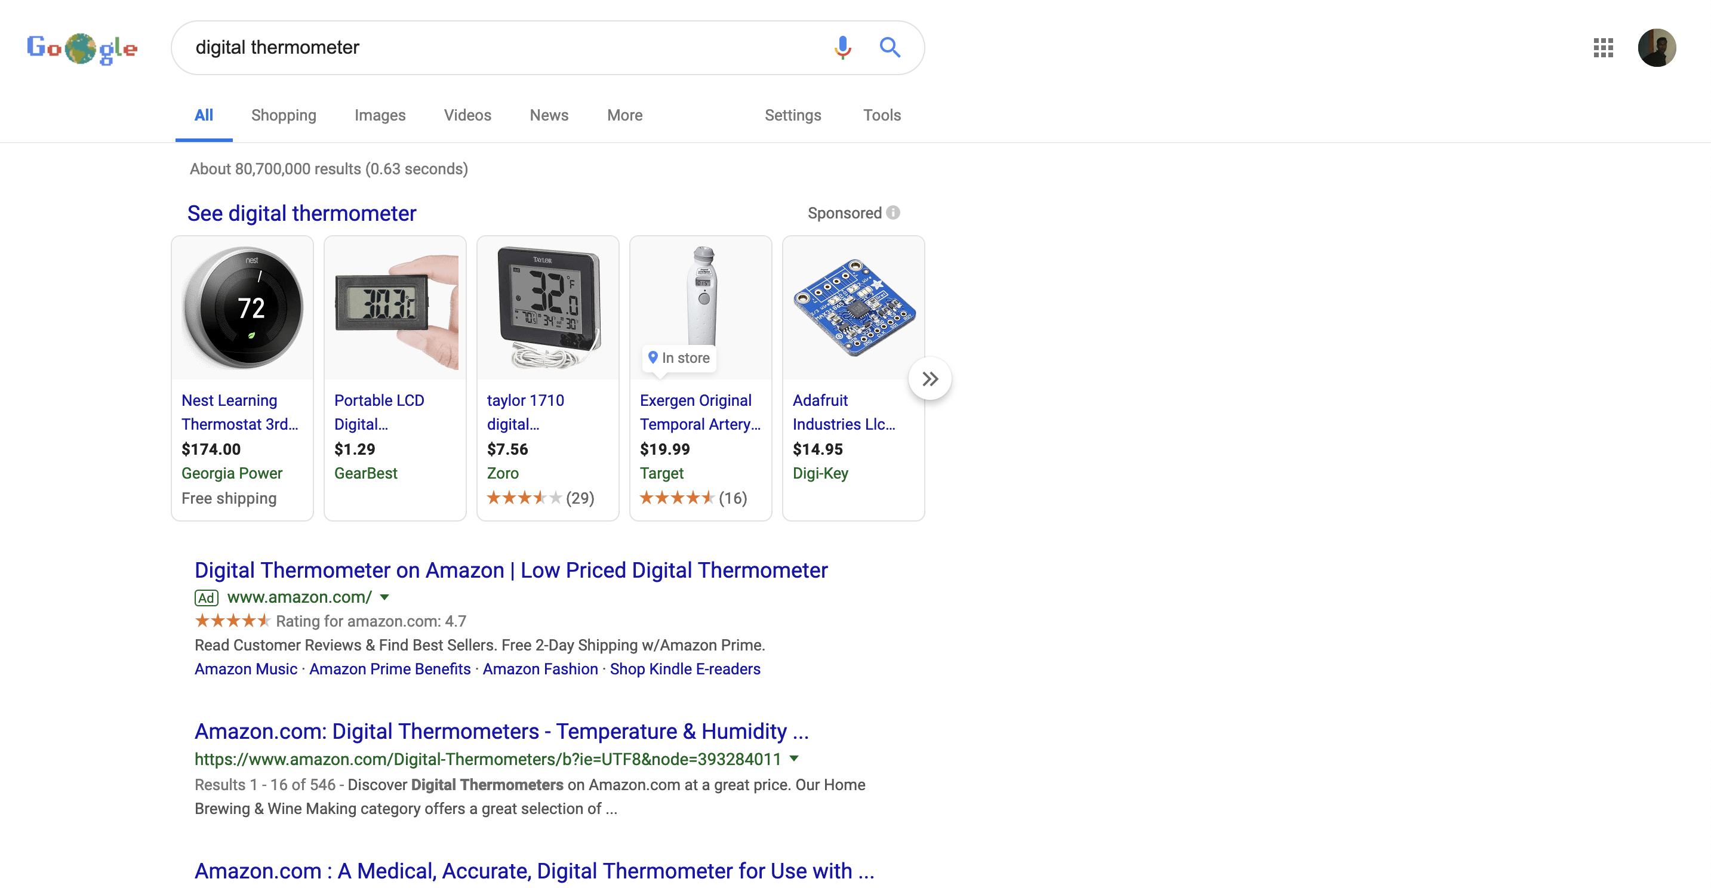
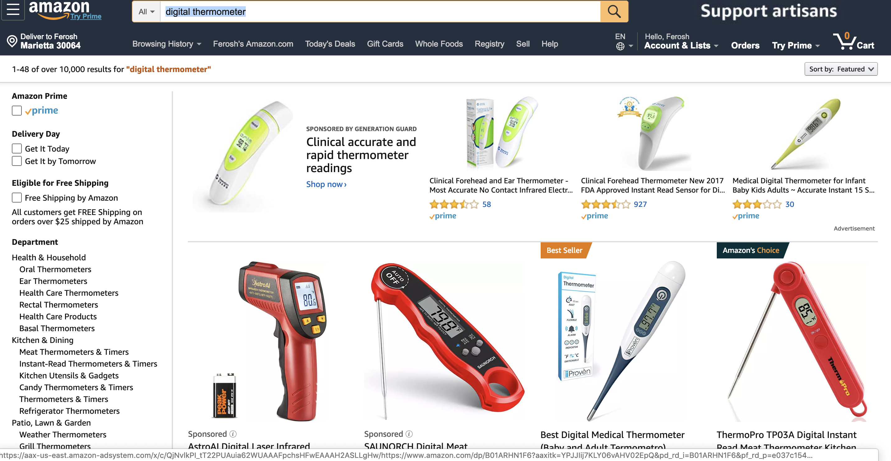
Why Google?

Slide 28

Google looks simple with a lot of white space?
Sponsored results and ads
Organic results
Snippets
Knowledge Graph panel
“People also ask”
Featured snippets or answer boxes

Slide 29
Either way, IR will continue to
Get complicated for the people working on it (guaranteed)
Get easier and cheaper for the people using it (may be)
Stay relevant for people

Slide 30
Q&A

